Slide 1

Data visualization on Fast food stores
Li Sun, Ruixie Fang, Jiawei Sun

Slide 2
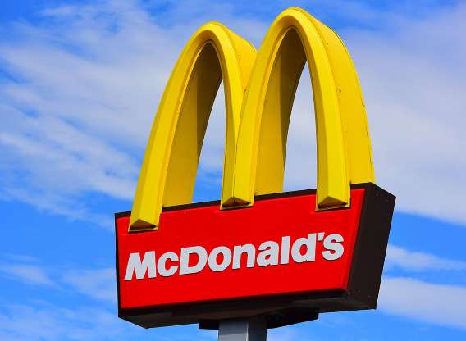
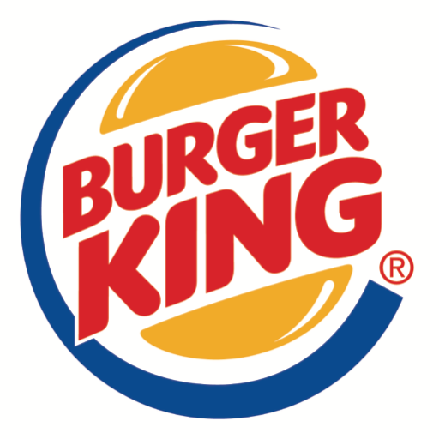
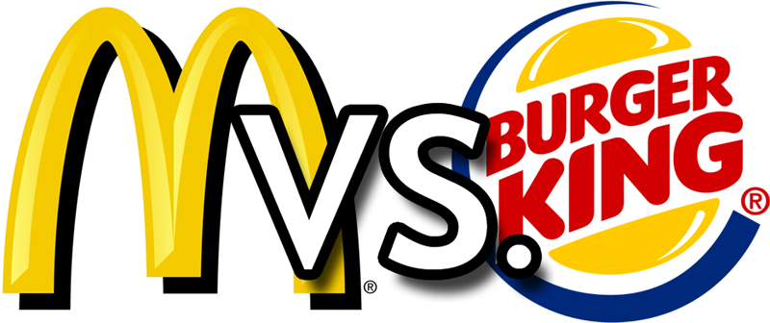
McDonald’s VS Burger King, what is your choice?
Notes:
If you want a fast food burger. You get to choose: for where there is a McDonald’s, there is often a Burger King nearby, many times right across the street.
If you’ve ever been to a mall, you’ll often find a surprising situation: stores like Target, Walmart, JCPenney and Kohl’s right nearby each other, often within walking distance.
It’s a strange phenomenon. Wouldn’t competitors choose to locate themselves farther from similar stores, to reduce competition?

Slide 3
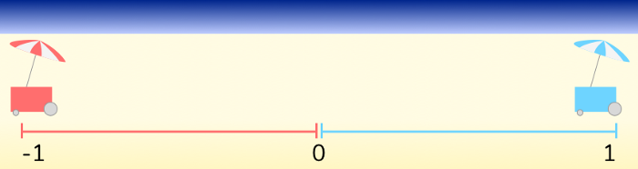
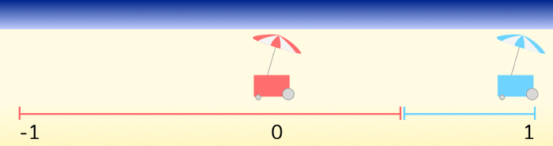
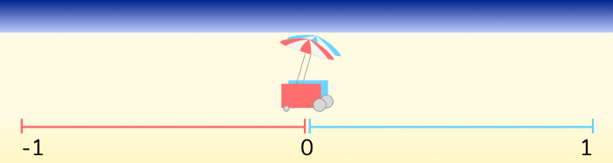
Hotelling’s Law
It is an observation in economics that in many markets it is rational for producers to make their products as similar as possible.
For McDonald’s and Burger King. After considering multiple game theories, they find the best strategy for selecting location for both is to build together.
Initially, both vendors have 1 unit market share of the beach.
The red one moving to 0, it captures an additional 0.5 of the beach.
Optimal solution for both competitors is to co-locate
Notes:
In the right images, we see two hot dog vendors, each starting at opposite ends of the beach and controlling half of the beach’s hot dog market.
However, there is an opportunity to increase market share!
Somewhat surprisingly, the optimal solution is for each hot dog vendor to locate exactly in the middle.

Slide 4
Goal
Show overall distributions of fast food stores in the U.S. and in each state.
Verify that Hotelling’s Law was used in location selection of fast food stores.
Learning and using Folium and Plotly as the tools to create data visualizations.
Notes:
50,000 lines contain McDonald’s, Burger King, Pizza Hut, taco Bell, Wendy’d, KFC, Jack, Hardee’s, Carl’s Jr., In-N-Out.
Mainland U.S. for each State and city, we have their latitude and longitude.

Slide 5
Our Project
Data
Using Folium and Plotly, we created visualization of locations of fast food stores.
Notes:
50,000 lines contain McDonald’s, Burger King, Pizza Hut, taco Bell, Wendy’d, KFC, Jack, Hardee’s, Carl’s Jr., In-N-Out.
Mainland U.S. for each State and city, we have their latitude and longitude.

Slide 6
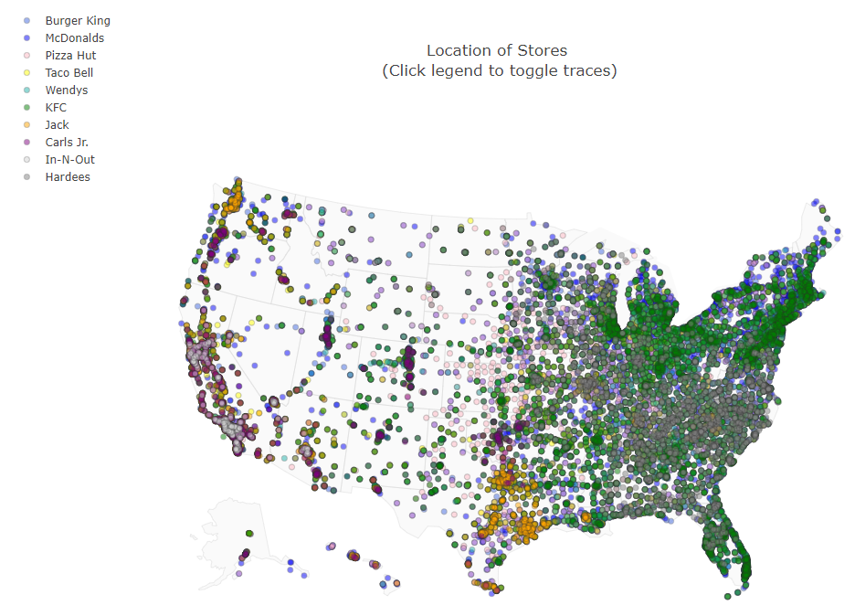
Data visualization results.
1. The figure that shows all types of fast food stores using Plotly.
Notes:
We also used map to mark all stores’ location.

Slide 7
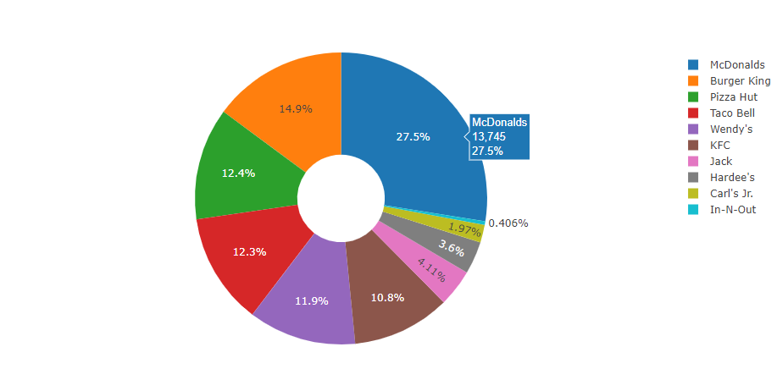
Data visualization results.
2. The pie chart that shows the amount of stores of ten fast food stores in the U.S.

Slide 8
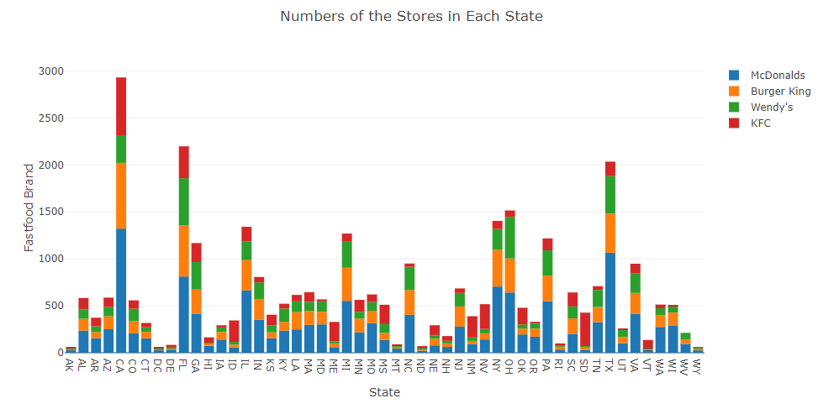
Data visualization results.
3. The figure that shows numbers of the stores in each state.
Notes:
The bar chart to show the distribution of stores in each state.

Slide 9
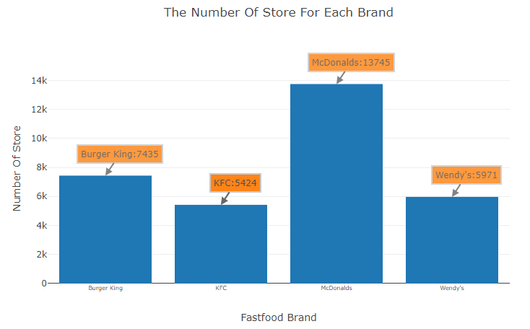
Data visualization results.
4. The bar chart that shows the amount of stores of Burger King, KFC, McDonald’s and Wendy’s.
Notes:
We select four stores that highly compete with each other which are Burger King, KFC, McDonald’s and Wendy’s. Because they all sell fast food burgers. Obviously, McDonald’s have the most amount of stores.

Slide 10
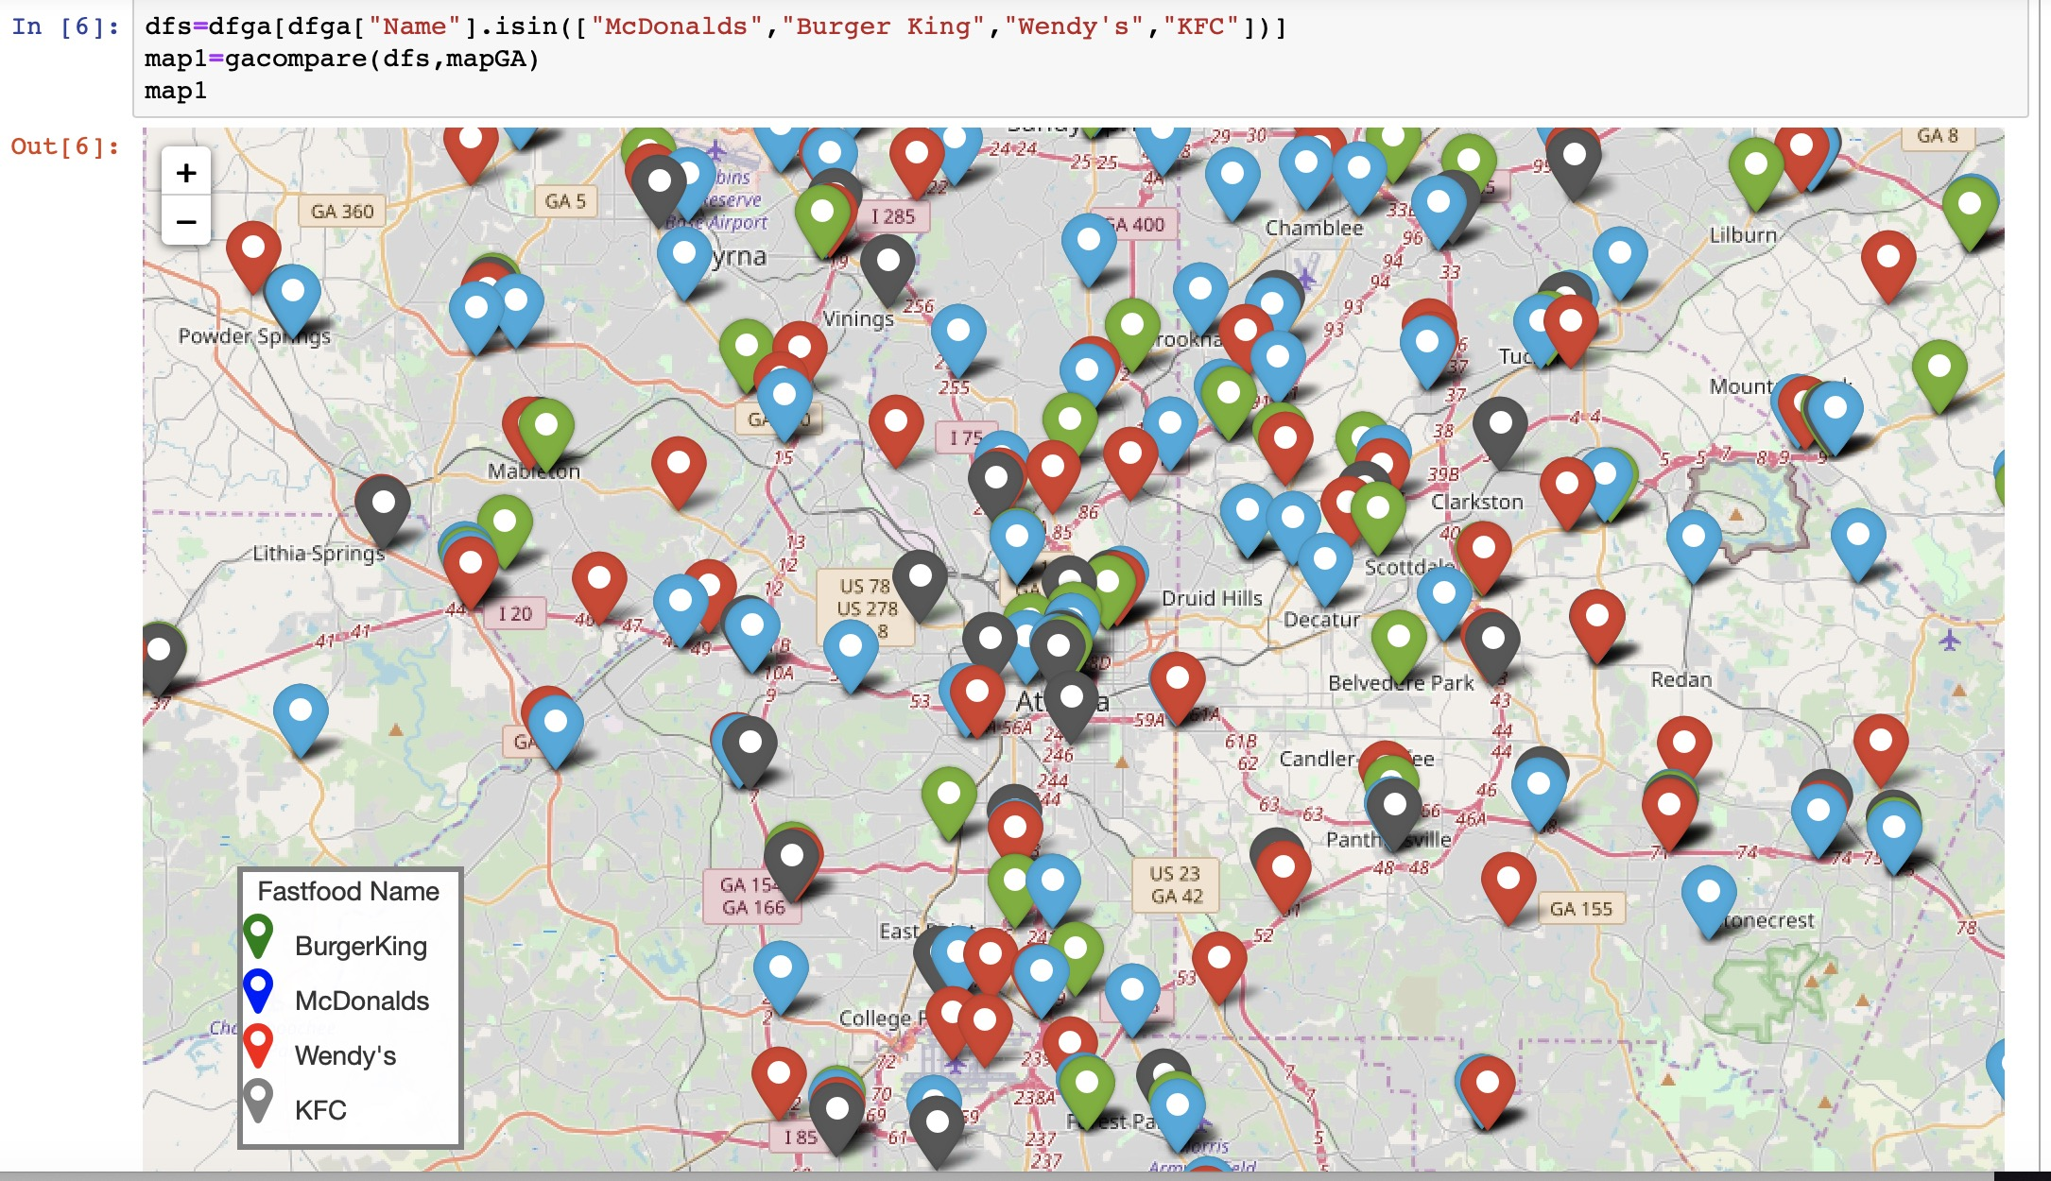
Data visualization results.
5. Compare locations of 4 types of stores in Georgia.
Notes:
Then we decide to verify Hotelling’s Law at Georgia and Florida .

Slide 11
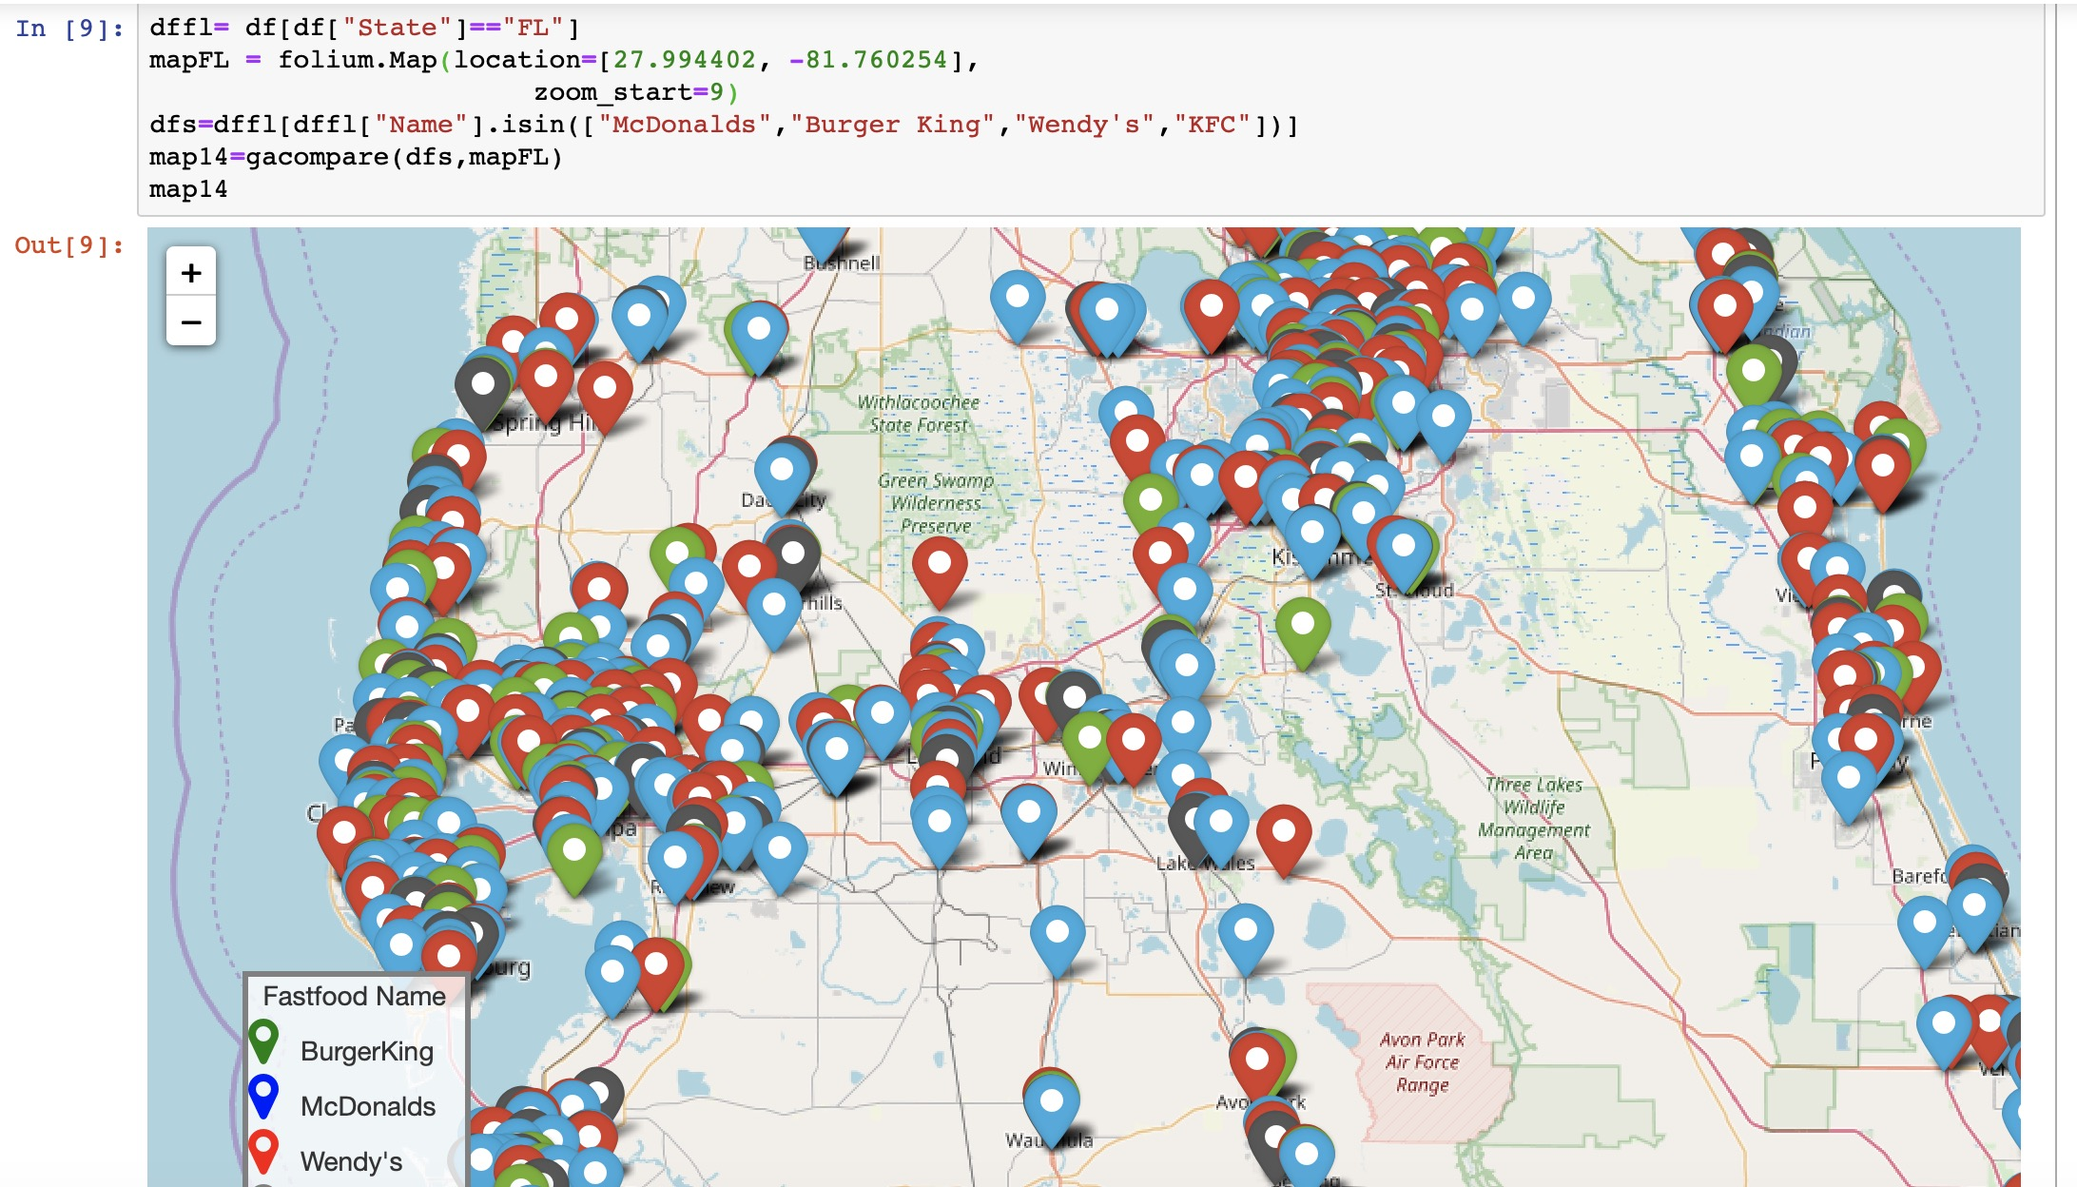
Data visualization results.
6. Compare locations of 4 types of stores in Florida.
Notes:
Then we decide to verify Hotelling’s Law at Georgia and Florida .

Slide 12
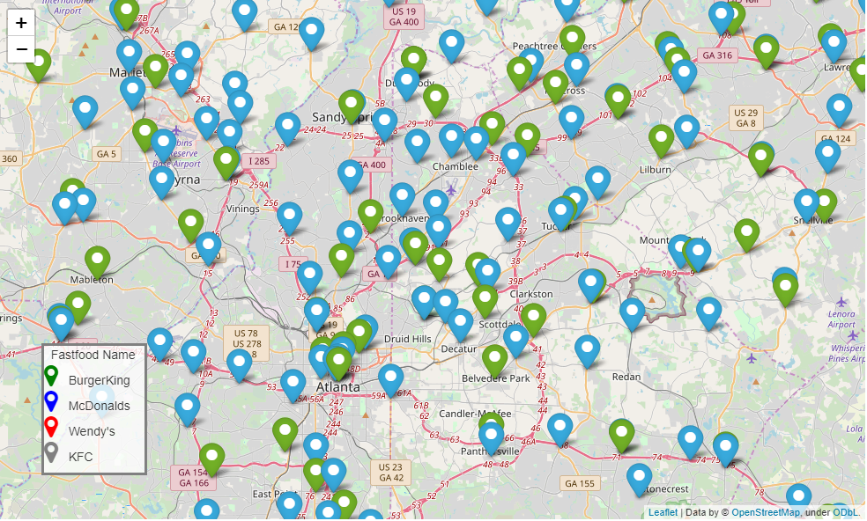
Data visualization results.
7. Compare locations of Burger King and McDonalds’s at Georgia.
Notes:
Then we decide to verify Hotelling’s Law at Georgia and Florida .

Slide 13
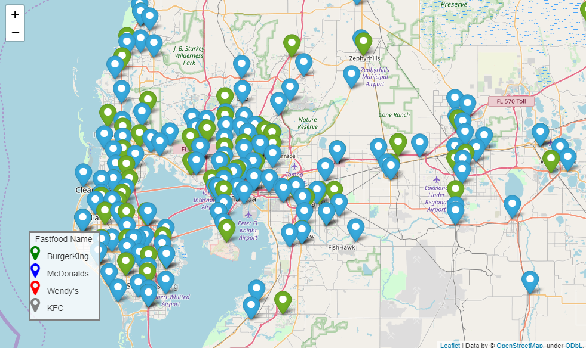
Data visualization results.
8. Compare locations of Burger King and McDonalds’s at Florida.

Slide 14
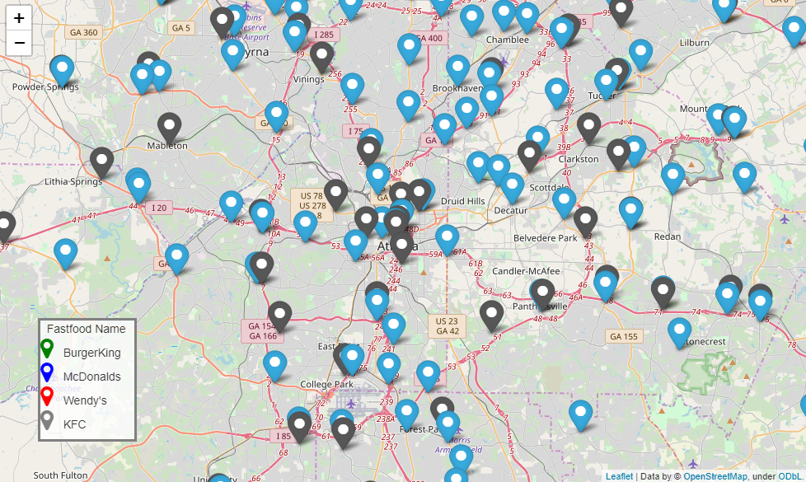
Data visualization results.
9. Comparation of KFC and McDonalds’s at Georgia.

Slide 15
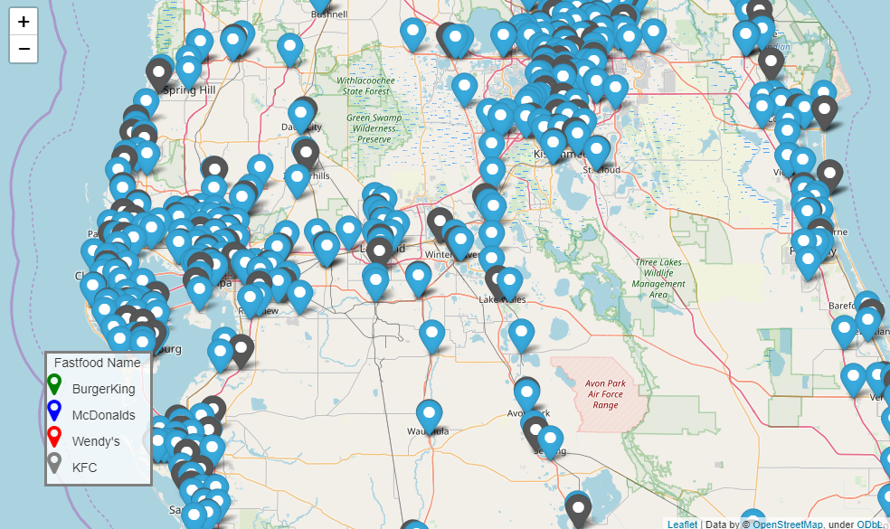
Data visualization results.
10. Compare locations at Florida of KFC and McDonalds’s.

Slide 16
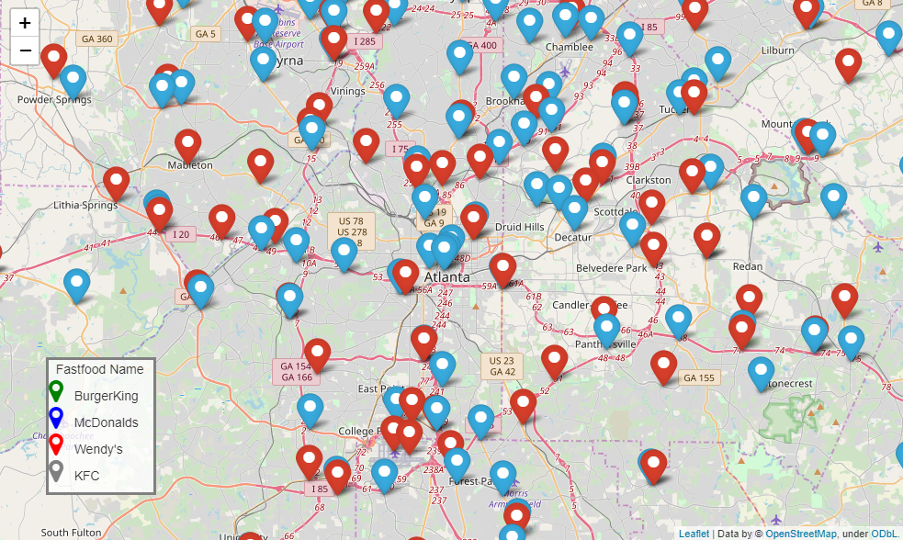
Data visualization results.
11. Compare locations at Georgia of Wendy’s and KFC and McDonalds’s.

Slide 17
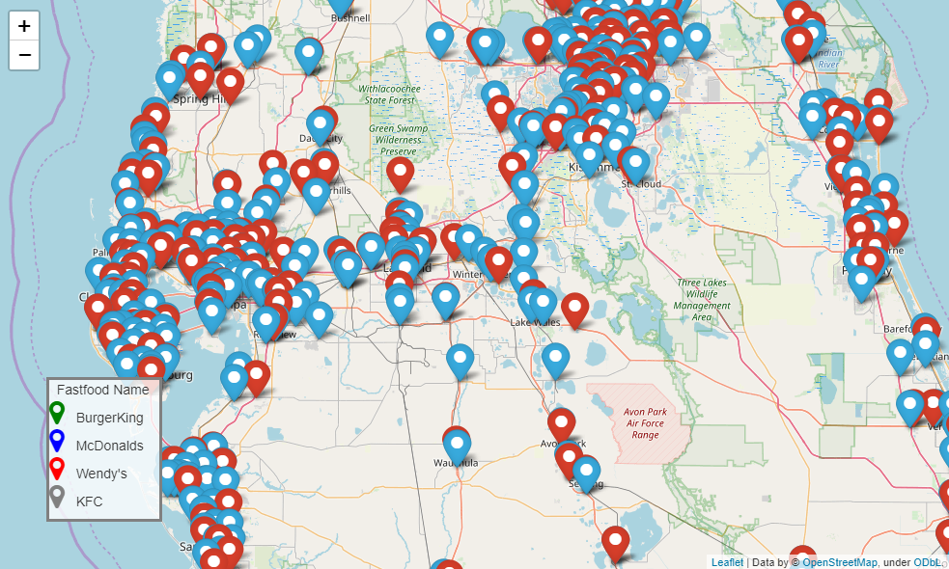
Data visualization results.
12. Compare locations at Florida of Wendy’s and McDonalds’s.

Slide 18
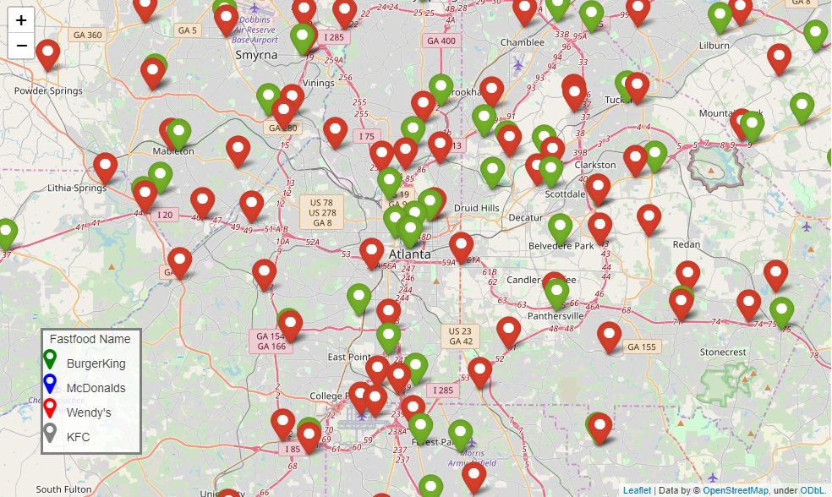
Data visualization results.
13. Compare locations at Georgia of Burger King and Wendy’s.

Slide 19
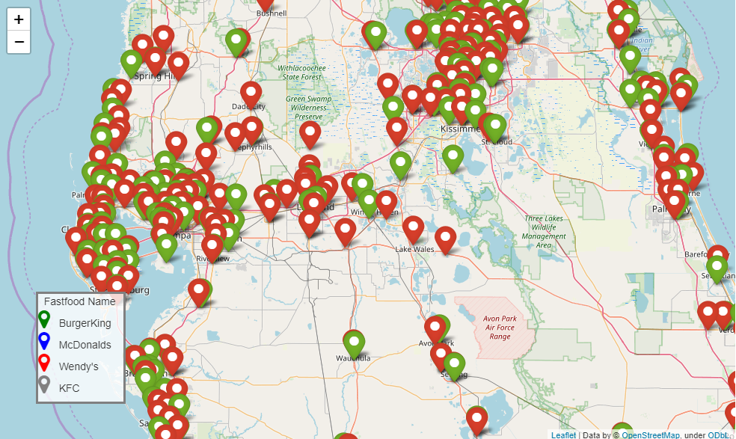
Data visualization results.
14. Compare locations at Florida of Wendy’s and Burger King.

Slide 20
Conclusion
McDonald’s has the most amount of stores in the U.S.
From our visualizations, we found that those fast food stores are always built together, which verified the Hotelling’s Law was used in selecting locations.
Same rule can be found not only fast food stores, it can also be found at:
Whole Foods and Trader Joes
Gas stations (think of how many gas stations share the same intersection)
Target, Walmart, JCPenney, and Kohl’s

Slide 21
Thank you!
Li Sun, Ruixie Fang, Jiawei Sun

